Slide 1
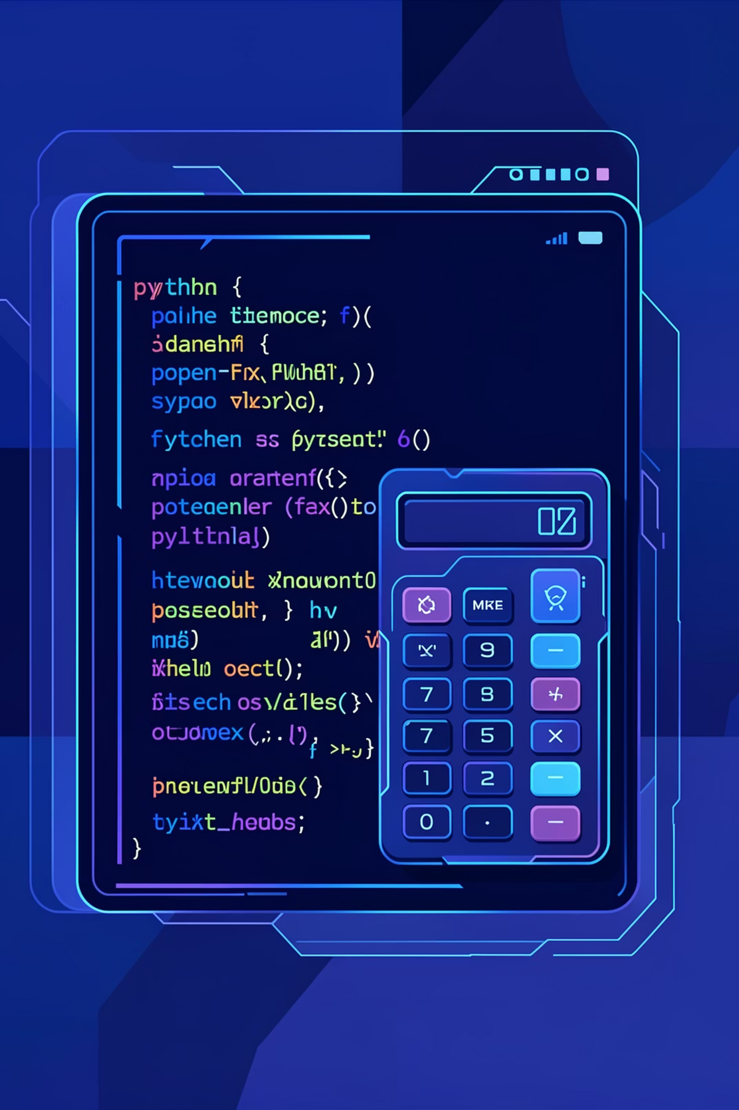
Nexthikes IT Solution
Python Calculator Project
Code Explanation: A Step-by-Step Guide
From : Palvinder Singh

Slide 2


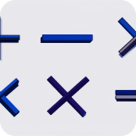

Introduction to Our Python Calculator
This presentation details the creation of a Python-based calculator, built using the Tkinter GUI library. Designed for simplicity and user-friendliness, it performs essential arithmetic operations: Addition, Subtraction, Multiplication, and Division.
Python-Based
Tkinter GUI
Core Operations
User-Friendly
Leveraging Python's versatility for robust functionality.
Utilizing Python's built-in library for graphical interface.
Handles fundamental arithmetic calculations with ease.
Intuitive design ensures a smooth and accessible experience.

Slide 3
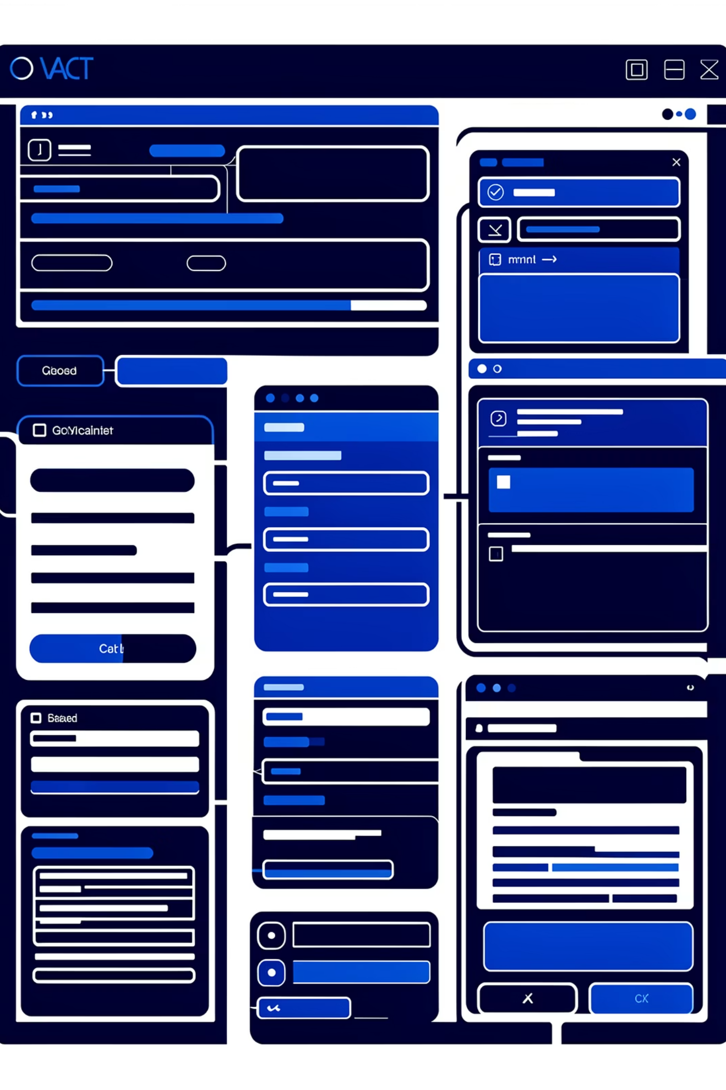
Understanding the Tkinter Library
Tkinter is Python's standard GUI (Graphical User Interface) toolkit, providing a fast and easy way to create desktop applications. It's built-in, meaning no extra installations are needed, making it ideal for developing graphical applications like our calculator.
Key Code Snippet
Tkinter's Role
Creates windows and dialogs.
Manages buttons, text boxes, and labels.
Facilitates interactive graphical elements.
Essential for designing user-friendly interfaces.
import tkinter as tk
This line imports the Tkinter library, aliasing it as 'tk' for convenience in our code.

Slide 4
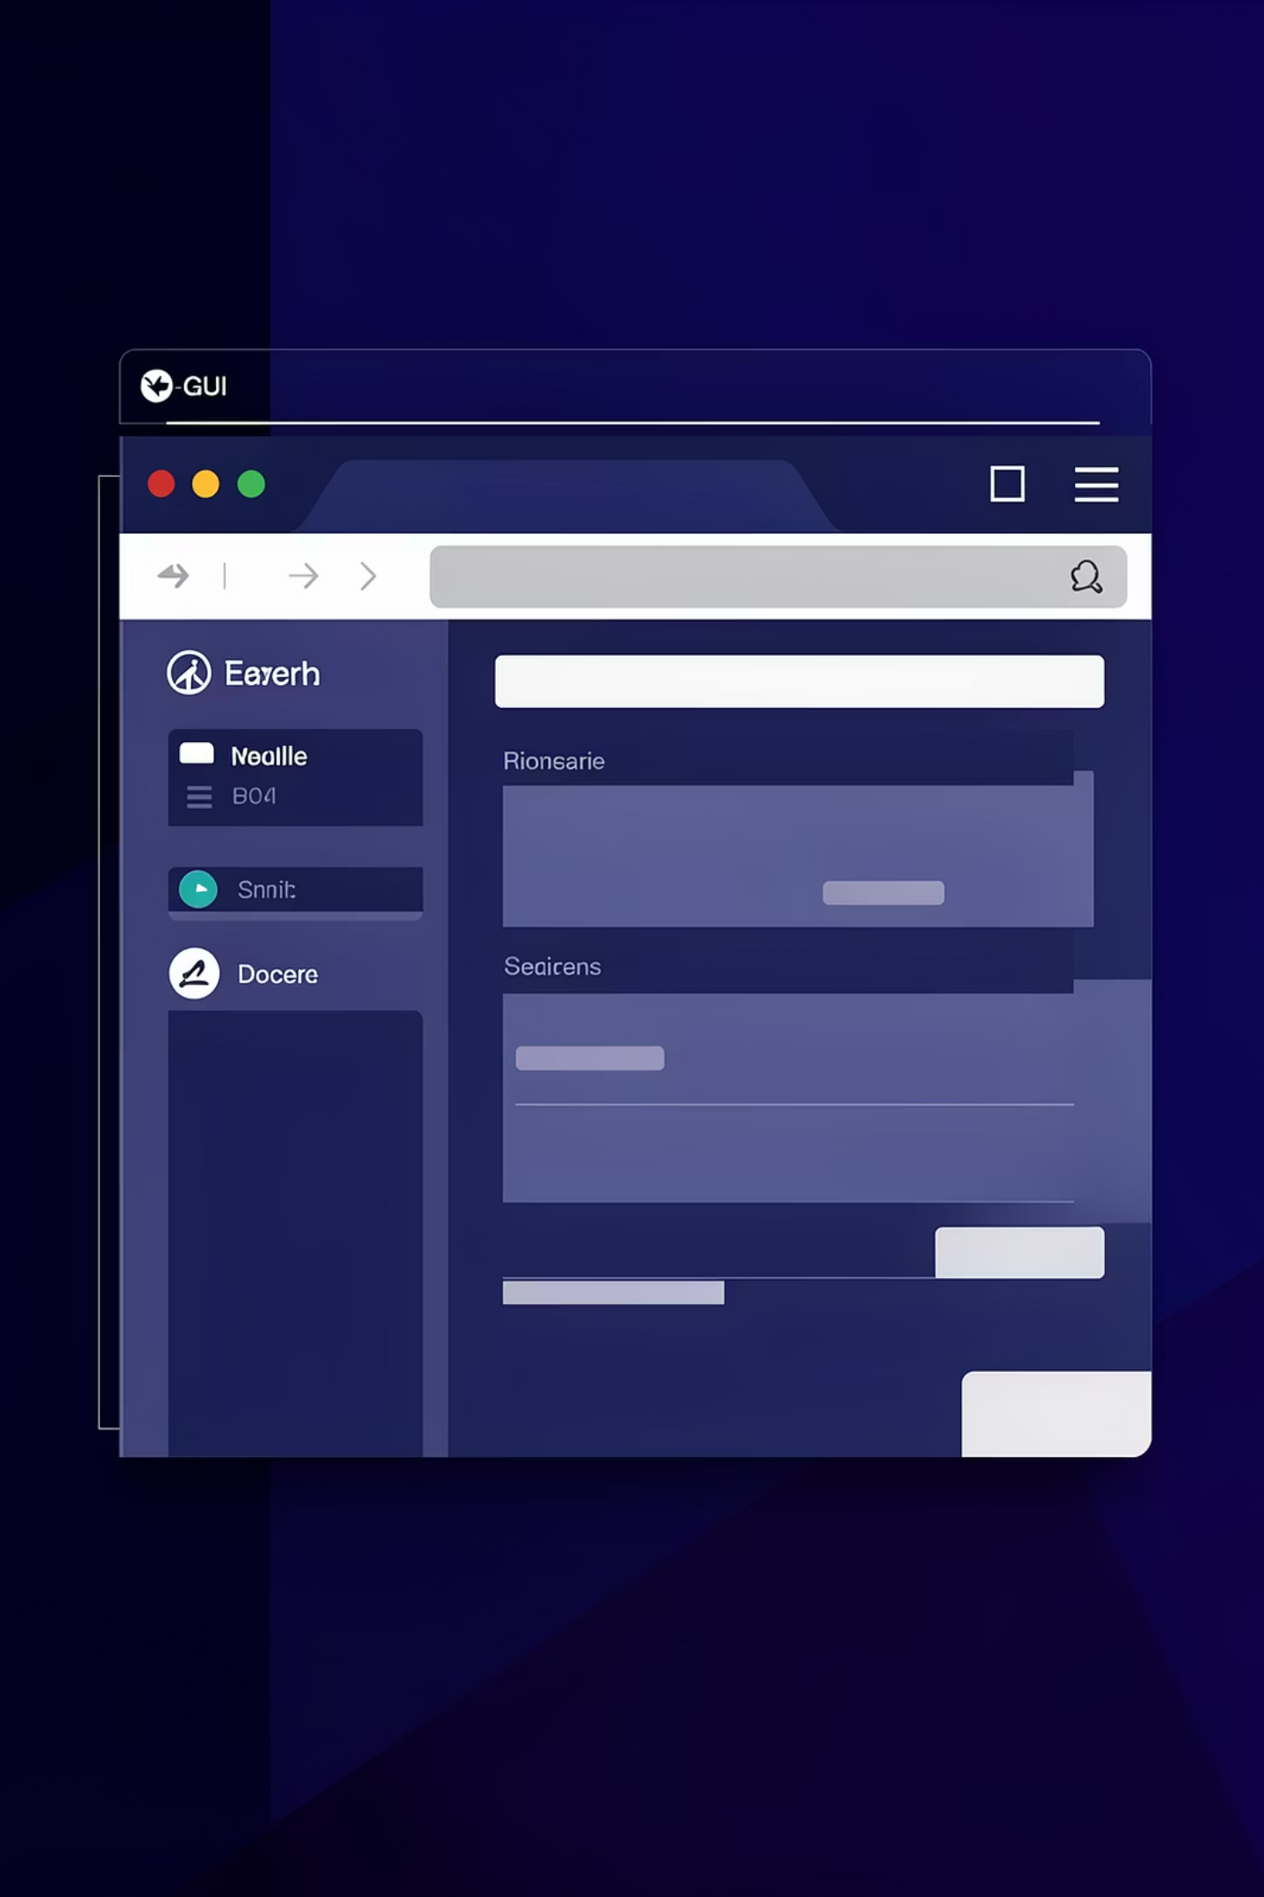




Crafting the Main Application Window
The foundation of any Tkinter application is its main window. We initialize this window, set its title, and define its dimensions to ensure a consistent and professional appearance. Disabling resizing prevents users from altering the layout, maintaining the intended design.
Initialize Window
root = tk.Tk() creates the primary application window.
Set Title
Assigns a descriptive title to the window for clarity.
Define Dimensions
Specifies the initial width and height of the calculator interface.
Disable Resizing
Ensures a fixed window size for a polished, professional look.

Slide 5
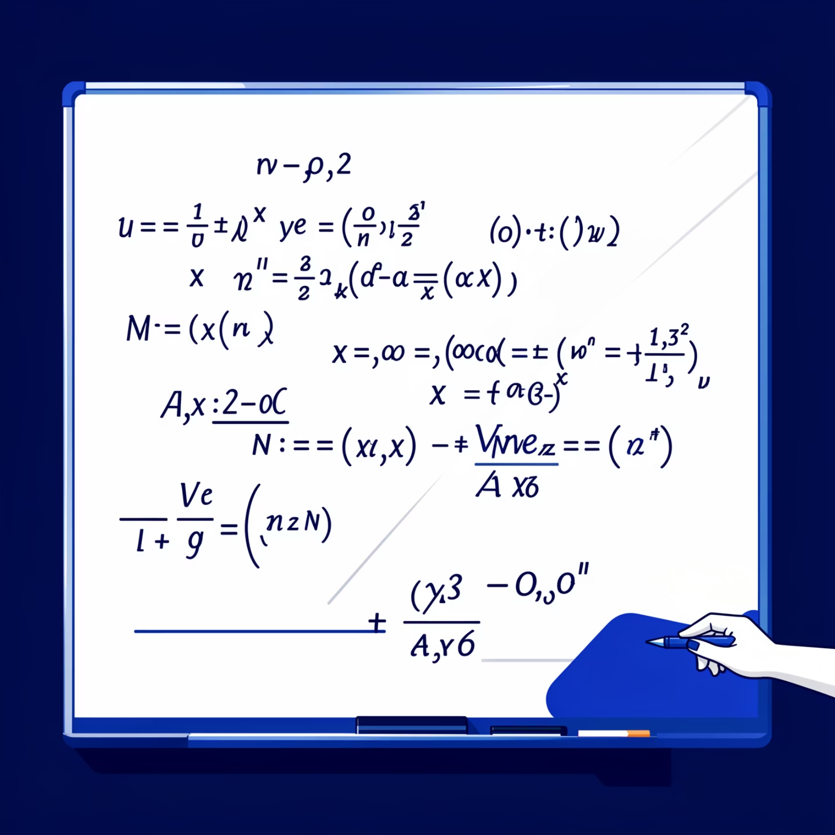
Managing User Input with the Expression Variable
The expression variable is crucial for our calculator, acting as its dynamic memory. It continuously stores and updates the sequence of numbers and operators entered by the user, forming the complete mathematical expression ready for evaluation.
Code Snippet
expression = ''
Functionality
Stores all user-entered numbers and operators.
Acts as the calculator's internal memory.
Updates dynamically with each button press.
Prepares the full expression for calculation.

Slide 6


Core Functions: press() and clear()
These two functions are fundamental to the calculator's interactivity. The press() function handles every button click, appending the corresponding value to the expression and updating the display. The clear() function provides a quick way to reset the calculator, erasing the current expression and clearing the screen.
press() Function
Adds the pressed button's value to the current expression.
Dynamically updates the calculator's display screen.
clear() Function
Resets the entire expression to an empty string.
Clears all content from the calculator's display.

Slide 7

The equal() Function: Calculating Results Safely
The equal() function is where the magic happens, using Python's built-in eval() to compute the result of the stored expression. A critical aspect of this function is its robust error handling, employing a try-except block to prevent crashes and display a user-friendly 'Error' message for invalid inputs, ensuring a smooth user experience.
Handle Errors
Use try-except to catch and manage exceptions.
Evaluate with eval()
Compute the stored expression safely.
This mechanism ensures that even complex or malformed expressions do not disrupt the application, maintaining stability and user confidence.

Slide 8
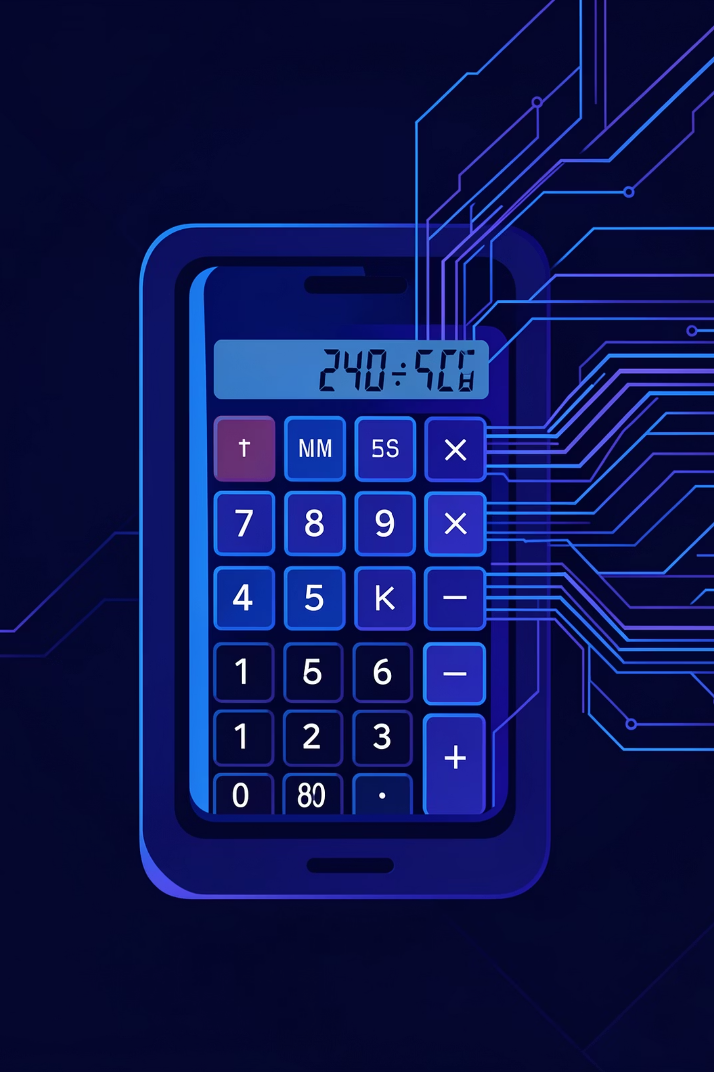
Dynamic Display with StringVar and Entry Widget
To provide real-time feedback, our calculator utilizes tk.StringVar() to link the internal expression variable to the visual display. The Entry widget then presents this content on the screen, automatically updating whenever the StringVar changes, ensuring the user always sees the current input or result.
Code in Action
How it Works
input_text = tk.StringVar()
StringVar acts as a bridge between Python variables and GUI widgets.
The Entry widget is configured to display the content of input_text.
Any modification to input_text automatically reflects on the calculator's screen.
Provides seamless and instant visual feedback to the user.
This line initializes a special variable that can be tracked by Tkinter widgets.

Slide 9
Efficient Button Creation Using Loops
Instead of manually creating each button, we employ a highly efficient method: storing button configurations in a list of tuples and then iterating through this list with a for loop. Each tuple contains the button's text, row, and column, allowing the loop to automatically generate and place all buttons. This approach significantly reduces code redundancy, making the codebase cleaner, shorter, and more maintainable.
01
02
Define Button Data
Iterate with for Loop
Buttons are organized in a list, with each item specifying text, row, and column.
A loop processes each button's data, automating its creation.
03
04
Generate Buttons
Clean & Efficient Code
Tkinter buttons are dynamically created and positioned on the grid.
This method ensures a concise and easily manageable codebase.

Slide 10







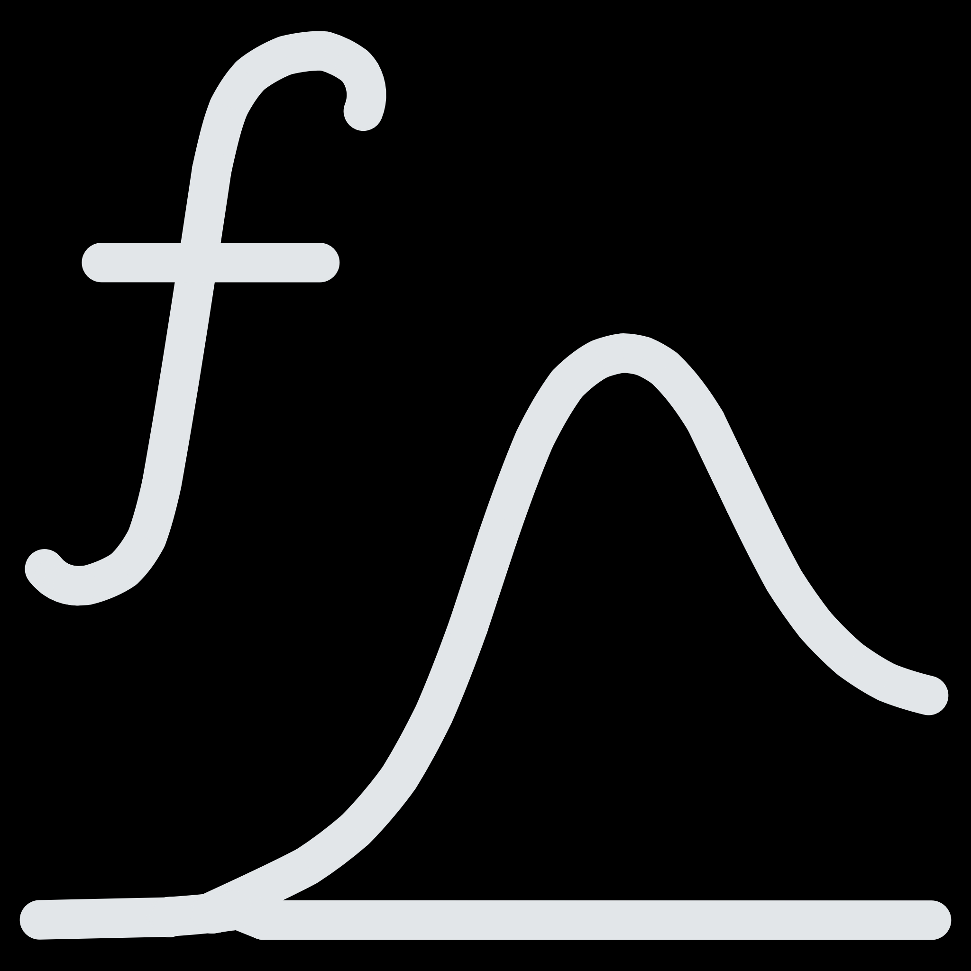


Conclusion: A Functional Python Calculator
Through this project, we successfully developed a fully functional Python calculator, integrating key programming concepts and libraries. We applied GUI design principles using Tkinter, implemented essential functions for user interaction, utilized loops for efficient component generation, and incorporated exception handling for robust error management.
GUI Application
Working Calculator
Mastered Tkinter for intuitive user interfaces.
Successfully built a practical and interactive tool.
Functions & Loops
Applied core Python logic for efficiency.
Enhanced Understanding
Deepened knowledge of practical Python concepts.
Exception Handling
Ensured robust and crash-free operation.

Slide 11
Thank You! 😊

